Slide 1
Civic hacking and citizens engagement for a better society
Notes:
This resource is focused on civic hacking and citizens engagement and aims to stimulate collective actions toward a better society.

Slide 2
Index
Be open-source
People
Gender differences or complementarities?
Community
Imaginary readings of the territory
Civic hacking
Women Hackers for inclusive society
Notes:
To explain what we mean and why civic hacking and citizens engagement are important for the future we want to achieve in our cities and territories, we will go through 7 points: What it means to be open-source? What kind of people can be civic hackers? There is a difference between women and men? And what about apply imaginary readings of the territory? After this long introduction, we will finally speak about civic hacking and about the role of women in this impactful and new movement.

Slide 3
Be open-source
Open-source as an attitude
Sharing knowledges and ideas
“innovate and don’t care about results!” (Matteo Tempestini)
Notes:
Let’s start our trip understanding what it means to be open-source. First of all, it is a personal attitude, a feeling, a behaving allowing people to be “open” and to share knowledges and ideas as much as possible.
It means also to be willing to speak with people and to discuss with them, also when opinions are not the same. Do you remember the metaphor “thinking outside of the box”? It’s that: think differently, unconventionally and from a new perspective to find solutions to problems we are facing today. New forms of interactions between people should be found and innovating our way of thinking will have a great impact on our lives. As an Italian civic hacker said some year ago, “innovate and don’t care about results!”.

Slide 4
People
Civic hackers are not nerd
Civic hackers can be programmers, designers, data scientists, good communicators, civic organizers, entrepreneurs, government employees and anyone willing to get his or her hands dirty solving problems (https://opengovdata.io/2014/civic-hacking/)
Everyone willing to trigger the change and to contribute to the life of the place where he/she lives can be civic hacker (Matteo Tempestini)
Notes:
So, people are the key actors in this process. Without them, nothing could be changed!
First of all, it is not a stuff for nerd (and after we will see that it is not something only-for-men). It is most important to be creative than to be able to use python! Civic hackers are curious people willing to get hands dirty solving problems, to trigger the change and to contribute to the life of the place where he/she lives. And to do so, the civic hacker adopts knowledges of other component of the “team” or of the “society” as a common heritage.
Can you describe yourself as a civic hacker?

Slide 5
Gender differences or complementarities?
Women score much higher than in men in Sensitivity, Warmth, and Apprehension
Men score higher than women in Emotional Stability, Dominance, Rule-Consciousness, and Vigilance.
Del Giudice, M., Booth, T., and Irwing, P. (2012). The distance between Mars and Venus: Measuring global sex differences in personality. PLoS ONE 7(1): e29265.
Notes:
Now let’s see if there are gender differences or complementarities being a curious person willing to contribute to the life of the place where he/she lives.
To explain differences between men and women, one of the worldwide bestseller of the 90s affirmed that men and women come from distinct planets: men come from Mars and women from Venus. By today, several studies were developed to confirm or to fight against that vision. We believe it is not a fact of differences, we love to see them as complementarities. Women and Men are the key actors to build the society we want: inclusive, open and peaceful. At the end of this resource we will see that all around the world there are several women hackers.

Slide 6
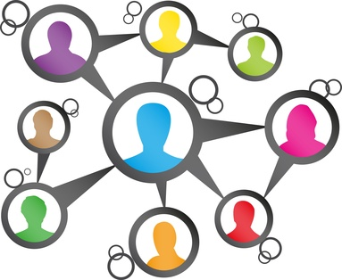
Community
It's the community that makes the difference, not the web
Notes:
It is a matter of community!
Relationship between women and men and between all actors living in a place will make the difference. Than the tool, the instrument used to facilitate this connection is of course important, but not vital.
So, when we talk about civic hacking we are not referring exclusively to web-based relationship but of human relationship – that could be mediated by ICT – able to produce results on the ground and to solve people’s problems.

Slide 7
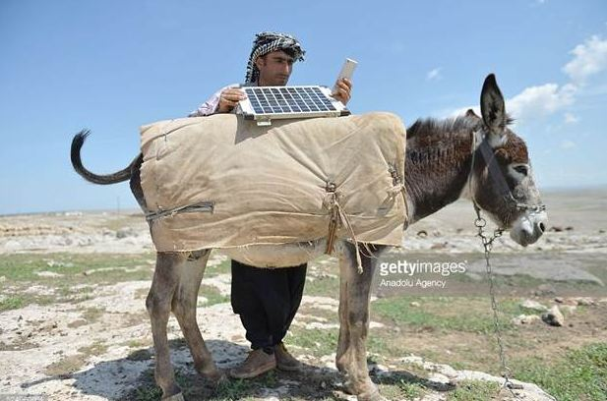
Imaginary readings of the territory
It's our right to imagine alternative readings of the territory and of our cities
Notes:
It's our right to imagine alternative readings of the territory and of our cities, like this young Turkish sheepherder using his donkey to carry solar panels and to use internet to keep up on the news and socialize while on their solitary trips outdoors.

Slide 8
Civic hacking
Citizens working together and creatively to make their cities better places for everyone
It's not just implemented through technology
The Web 2.0 has increased opportunities for social connectivity and crowdsourcing, increasing opportunities for collaboration among governments and citizens
Notes:
And to summarize: Civic hacking involves all citizens willing to work together and creatively to make their cities better places for everyone.
It's not just implemented through technology but of course the Web has increased opportunities for social connectivity and of opportunities for collaboration.

Slide 9
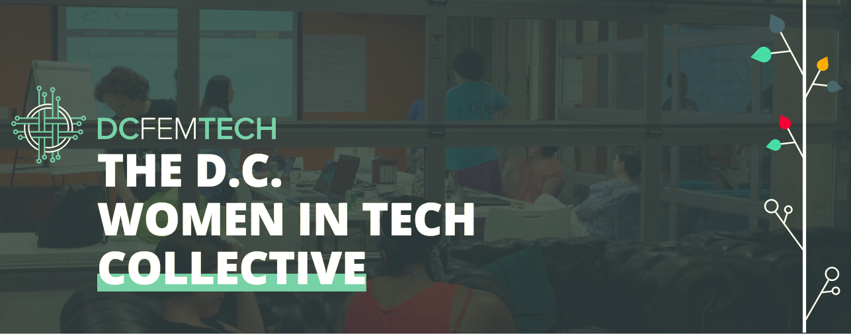
Women Hackers for inclusive society (1)
Notes:
Last issue we would like to speak about is the role of women in the civic hacking movement. As said, civic hacking is not a men-related-activity and all around the world there are several feminist hacktivists by which:
- the THF, a group of women that aims to create a community caring about filling the gap in women participation in technological fields and in hacking
- the DCFemTech, a coalition of women leaders promoting diversity and lowering the barriers to entry for women in tech
- the “Feminist Hacker Space” willing to provoke, stimulate, and re-imagine new possibilities for technical and technological feminist practices and other critical practices anchored in activism.

Slide 10
Women Hackers for inclusive society (2)
It is important to create a moment and a place for citizens and the government to solve together interesting challenges
It is important to foster citizen engagement at local and regional level
It's important to enable citizens to get involved in governance issues by opening up data and creating challenges
Source: http://dhmncivichacks.blogspot.it/2015/07/36-benefits-of-civic-hacking.html
Notes:
To conclude, take a look to the poster of “Rosie the Riveter”. It is the worldwide recognize image always used as a call to inspire women. And we are using it to inspire you and all citizens.
In fact, it is important
- to create a moment and a place for citizens and the government to solve together interesting challenges
- to foster citizen engagement at local and regional level
- to enable citizens to get involved in governance issues

Slide 11
Thank you!
This project has been funded with support from the European Commission.
This document reflects the views only of the author and the Commission cannot be
held responsible for any use which might be made of the information contained herein.
Project Number: 2017-1-FR01-KA204-037126

