Slide 1
Amplify Community Voices
Notes:
This resource aims to provide ideas and generate discussion on how migrants and migrant communities can use various media forms to share their stories and opinions. It encourages individuals to consider what are the existing media forms of our era, both in their traditional and new online forms. It briefly explains what community media is and provides examples. It then invites migrants to reflect on what available opportunities exist in their communities to share their stories and design ideas on how they can use these opportunities or create new ones.

Slide 2
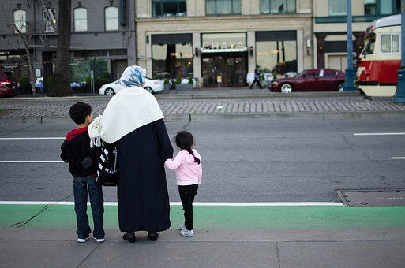
We all have our own story
Notes:
Each person has a story to tell. Across Europe, millions of persons, EU and non-EU nationals have migrated to different countries seeking for a better future. Non-EU migrants arriving in Europe do so for a variety of reasons. Migration in Europe is not a new phenomenon.

Slide 3
Notes:
However, with the war in Syria and the mass movement of Syrian refugees, the issue of migration attracted a lot of attention from national and international media. They frequently report on the numbers of arrivals, the dangerous crossing of desperate migrants and refugees across the Mediterranean, the problems this migration creates to European countries and the various policies of the European Union and Member States to manage migration. Yet, these news are usually not aiming to inform migrants themselves, nor do they bring to the public discussion the views and opinions of migrants and refugees. These makes migrants and refugees excluded from a discussion that directly concerns them.

Slide 4
Community Media
Notes:
Community media can be an alternative to empower migrants and refugees and offer them a platform to share their experiences, views and opinions, therefore amplifying their voices.
What is Community Media? It is
“Media for the Community – by the Community”
Community media are local, independent not-for-profit media which provide access to training, production and distribution facilities for various groups and communities that are under-represented in the mainstream media. All members of the community are welcome and encouraged to participate in all aspects of the production. From content development to distribution, they offer a voice to marginalised groups and contribute to community development, social inclusion and intercultural dialogue.

Slide 5
“Community media aim at providing access to communication on the community’s own terms, meaning that they allow participants to make their own news, whether by appearing in it as significant actors or creating news relevant to their situation, correcting imbalances derived from the media content produced in mainstream media.” Council of Europe Report “Spaces of Inclusion”
Notes:
According to the Council of Europe Report “Spaces of Inclusion”:
“Community media aim at providing access to communication on the community’s own terms, meaning that they allow participants to make their own news, whether by appearing in it as significant actors or creating news relevant to their situation, correcting imbalances derived from the media content produced in mainstream media.”

Slide 6
Community Media
independent
non-profit
participatory
socio-economic development & culture
Notes:
As reported by the Deutsche Welle Akademie, although there is no single definition for community media, there are at least four characteristics widely agreed on:
It is independent from governments, donors, advertisers and other institutions.
It is not-for-profit: any surplus made is reinvested in the station and the community.
Participation is possible for all community members and at all levels – programming, operating and even financing.
Community media outlets support and contribute to their community’s social, economic and cultural development.

Slide 7
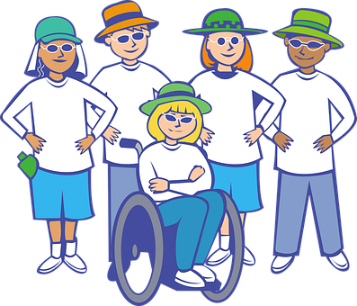
Community Media
Notes:
Community media can be used by different types of communities. These can include:
A group of people living in the same geographic location (local community)
A group of people who share and defend same interests (like students, refugees, women or sexual minorities)
An ideological community, that is a community connected by shared ideals, beliefs or causes. This category can include social movements, political or religious groups.
An ethnic community, such as a small minority or migrants from the same ethnic community.

Slide 8
Forms of Community Media
Notes:
Community media can exist in all the different media forms. The most prevailing ones are:
Community Radio
Printed Newspapers and magazines. These can include articles, short stories, opinion pieces and the use of photos.
Television
Online media and the use of new technologies, such as online newspapers, blogs and videos.
Groups can also harness the potential of social media such as facebook and twitter to disseminate their message.
Below you can see some examples of community media

Slide 9
Community Radio
Notes:
My-CY-radio is Cyprus’ first community radio station, established by the Cyprus Community Media Centre (CCMC)
It is a not-for-profit radio station, ran by volunteers from the community. My-CY-radio provides a platform for a diversity of voices in Cyprus to be heard, while also highlighting cultural and linguistic diversity, encourage social integration, and promote a culture of active citizenship and participatory democracy.
It offers a space where anyone can learn how to use the radio and run her own radio show. MYCYradio hosts over 40 radio broadcasters representing a number of different communities from across the island, including migrants and refugees. Among its programmes, it has a show on social integration run by refugees.
Its programmes are also available to download in podcast format immediately after the end of each show.

Slide 10
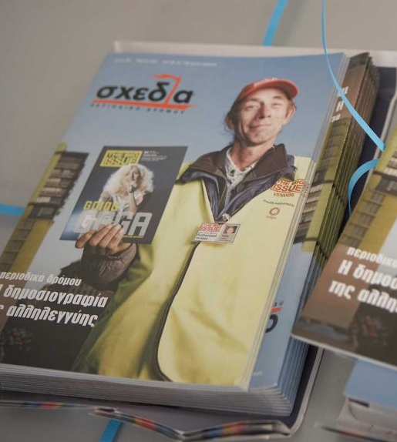
Street Magazine
for the Homeless
Notes:
Shedia – the street paper for the homeless of Athens.
Shedia, which in greek means “Raft” is a the first and only street paper in Greece. It is not sold in the usual selling places, rather it is solely sold in the streets of Athens or Thessaloniki by accredited vendors. At its launch, it had 70 accredited vendors. Each vendor initially received 10 issues for free, which he could sell for 4 euros each. That was their initial capital. With that money, he could buy more issues of shedia at 2.5 euros each and re-sell them, therefore creating his own micro-enterprise and earning a small dignified living. At the forefront of this initiative fighting poverty, marginalisation, isolation and social exclusion.

Slide 11
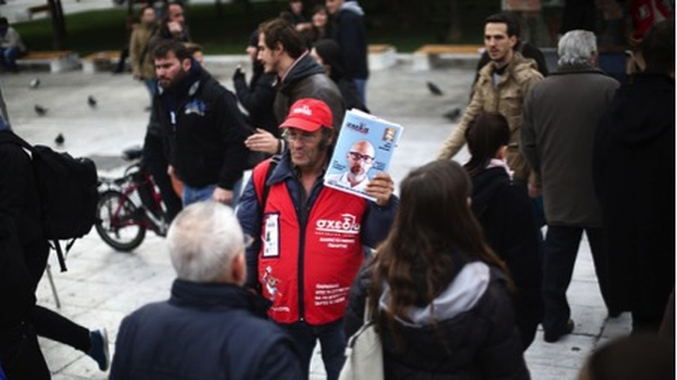
Street papers
Notes:
Street papers / magazines to support the homeless exist in at least 41 countries across the world. In many cases, homeless persons are not only the magazine vendors, but they also take part in its production and writing the content of the magazine. The street paper offers them the opportunity to acquire new skills and to share their views and experiences with their society.

Slide 12
“how do you make someone independent? ... it’s by gradually giving them control over the process and giving them the space to experiment and so now on a Wednesday morning you have Joyce getting there at 9 -9.30, she’s already taken the kids to the childminder, she jumps on the Internet starts looking for news, reads her emails. (...), Ameneh’s gone off and done an interview at Zion Arts Centre, caught the bus by herself, comes back and does the editing. And suppose if you contrast that to the first couple of weeks when you saw them come into the room and Ameneh had been here for 2 or 3 years and hadn’t caught a bus, Joyce had never used a computer, she wanted me to go to the nursery with her cos she was worried they wouldn’t understand her English and now she’ll jump on the phone and talk ...the self-confidence and the independence...” Project Manager, “Radio for Refugees” taken from “Spaces of Inclusion”, Council of Europe Report (2018).
Notes:
Read the following passage from an interview with the Project Manager of the “Radio for Refugees” project.
“how do you make someone independent? ... it’s by gradually giving them control over the process and giving them the space to experiment and so now on a Wednesday morning you have Joyce getting there at 9 -9.30, she’s already taken the kids to the childminder, she jumps on the Internet starts looking for news, reads her emails. (...), Ameneh’s gone off and done an interview at Zion Arts Centre, caught the bus by herself, comes back and does the editing. And suppose if you contrast that to the first couple of weeks when you saw them come into the room and Ameneh had been here for 2 or 3 years and hadn’t caught a bus, Joyce had never used a computer, she wanted me to go to the nursery with her cos she was worried they wouldn’t understand her English and now she’ll jump on the phone and talk ...the self-confidence and the independence...”
Project Manager, “Radio for Refugees” taken from “Spaces of Inclusion”, Council of Europe Report (2018).

Slide 13
Case study and discussion
What has been the importance of the “Radio for Refugees” project? How did it impact the refugees that were involved?
What were the roles and responsibilities of these two refugees?
Can you think of other roles that someone can have in a community media outlet?
Notes:
Consider the following questions:
- What has been the importance of the “Radio for Refugees” project? How did it impact the refugees that were involved?
What were the roles and responsibilities of these two refugees?
Can you think of other roles that someone can have in a community media outlet?

Slide 14
Exercise Create your own community media
What community media can be used by your community?
In small groups or as an individual, can you think of a community media that you can use to give voice to your community and share your views, experiences and talents with the society where you live?
Notes:
What community media can be used by your community?
In small groups or as an individual, can you think of a community media that you can use to give voice to your community and share your views, experiences and talents with the society where you live?

Slide 15
Exercise Create your own community media 2
Action Plan
Type of media:
Forms of Expression:
Target Audience:
Production:
Distribution:
Cost:
Other?
Notes:
With your group, design an action plan to create your own community media. You can consider questions such as:
What type of media would be the most suitable for your community to share your message?
What forms of expression would you prefer using? (written articles, writing your stories or experiences, writing your opinion, using photos, video etc?)
What will be your target audience?
How can you produce the content and media?
How will you distribute it?
Is there any cost associated? How could you find these resources?

Slide 16
Additional
Reading
“Spaces of Inclusion – An explorative study on needs of refugees and migrants in the domain of media communication and on responses by community media” (2018). A Council of Europe Report prepared by COMMIT – Community Media Institute.
Available at: https://rm.coe.int/dgi-2018-01-spaces-of-inclusion/168078c4b4
“Media for the community, by the community” (2015). By Esther Dorn-Fellermann, published in DW Akademie. Available at: http://p.dw.com/p/1FX2T
“Alternative and Community Media”
http://www2.amk.fi/digma.fi/eetu/www.amk.fi/opintojaksot/0702010/1204871263088.html
Notes:
If you would like to learn more about community media and their role in amplyfing the voice of marginalised groups, you can check out some of these resources.

Slide 17
Thanks!

