Slide 1
Diversity as an advantage
Notes:
Question of values and cultural identity is a multidimensional question which concerns all of us, especially immigrants. This resource outlines the importance of providing stronger protections for immigrants especially immigrant woman.

Slide 2
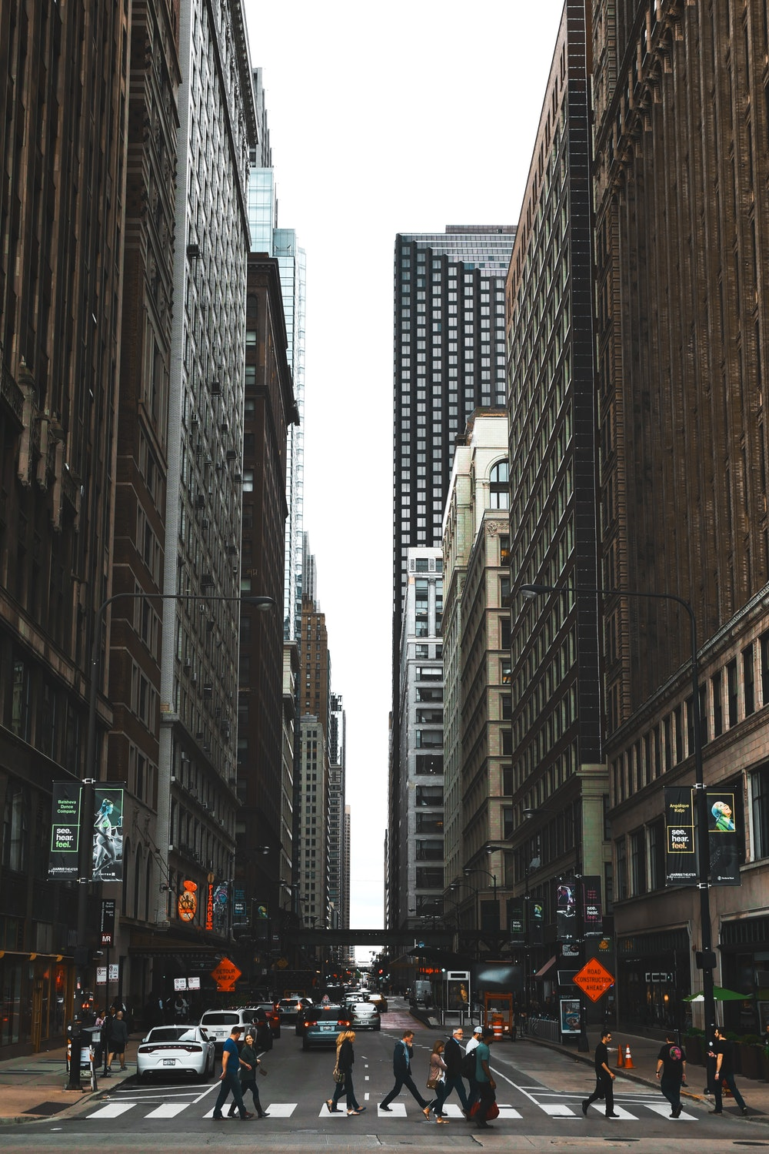
Values and cultural identity
material
economic
scientific
technical
biological
natural
social,
aesthetic
cultural
spiritual
religious
moral
solidarity
Notes:
Values and cultural identity is very sensitive question - especially for immigrants and refugees. They live and work trying to integrate their cultural identity into a new environment but also maintaining connection with their homeland. “Culture shock” experience (although is temporary) may bring a lot of vulnerabilities and lot of barriers.

Slide 3
Partly inherited - partly chosen
Notes:
There are two important misconceptions: identity depends on ourselves or identity is static. Whither we choose them or they us values and cultural identity are partly inherited and partly chosen.

Slide 4
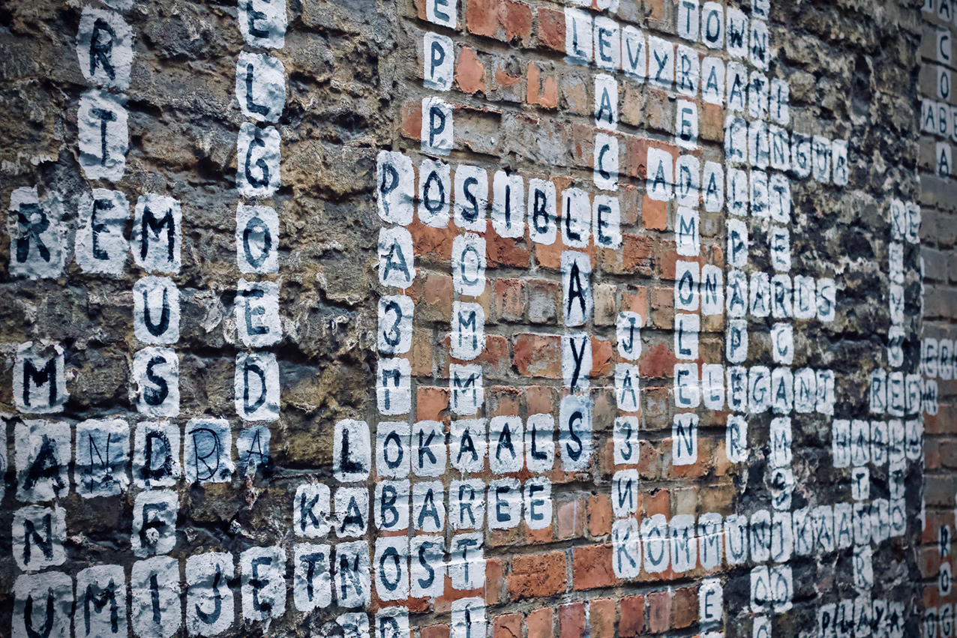
Notes:
Whether we choose them or they choose us each individual perceives himself uniquely and by some characteristics different from all other people. On the other hand every man is aware of his own slogans with other people, which is particularly pronounced when they belong to the same social group.

Slide 5
Game: None of us are racists, but ..
Notes:
Motives: prejudices, stereotypes and conflicts of different minorities
Goals: Encourage stereotypes and prejudices of participants on the other individuals, minorities and "different" to raise self-awareness about limitations of tolerance and conflict resolution contrast different values of participants.
Preparation: work paper for each participant, pencil
Instructions: Divide the work paper. Briefly expose the scene, examine with it the participant would have travelled with it, and with whom he would not travel. Summon the group of 4-5 participants and make a unanimous list of people. Every group exposes their views (talk of co-operation within the group)
Summary and Evaluation: Discussion will be conducted on a group basis reports. Comparing different results is also an introduction to the discussion.
Duration: 15 min

Slide 6
Social integration: we and others
Notes:
It often happens that members of minority groups, in contact with a large group, develop low self-esteem, because they are perceived as members of the inferior group. Migrations bring new pressures on all levels of identity. By changing the interaction framework the migrant has to change the social and personal identity. The social pressure to redefine all of it happens at the same time as a personal identity is in crisis because it has to synthesize leaps in the biography.

Slide 7
Sample Case Study
Naida
Syria
Female
25years old
Married
1 Child aged 6
Trained as a carer
Notes:
Naida is a twenty-five year old mother from Alepo who has recently arrived in Europe with her family. Naida and her family are muslim. They have found a doctor but they cannot find a local church, school, job or any long-lasting home. They live in infirmary almoust for 3 months. She would like to integrate into the community but she does not know the language nor the culture.

Slide 8
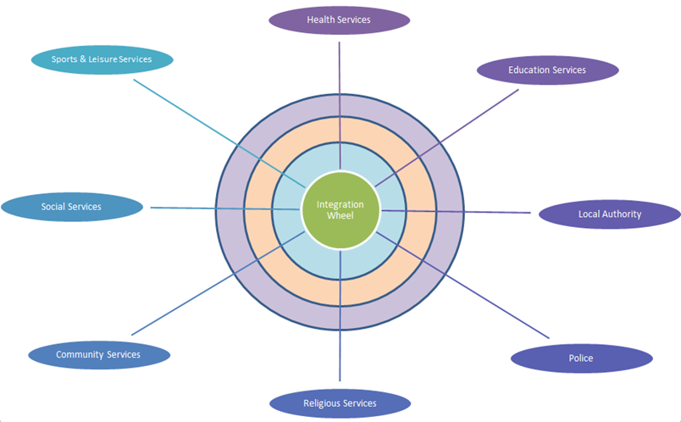
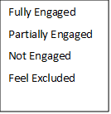
Naida’s Integration Wheel
Notes:
Naida has marked on the wheel the areas where she feels she has fully engaged, partially engaged, not engaged or feels excluded. Naida’s integration wheel clearly identifies areas that she needs to focus on if she is to achieve a holistic integration into her new host community. How can we help Nida to complete her integration? Do we recognize marginalized women and hear them? If so, what are they telling us, and if not, why not, what are their stories and needs, what does it teach us? Is there a margin of opportunity to be a space of resistance?

Slide 9
SCENARIO
Naida want to get engage in social services, religion services and education services.
She is coming in center of local community services.
Through conversation she became aware different values of this country so she decide to fully engage in local services so that she can be part of movement that encourage diversity in local community.
Naida start to work as a leader of a small group which provide others learning about her culture.
Naida is also attending other cultural groups so that she can learn more about country where she is staying now which will give her an abilitiy to became easily integrate in this community and social, religion and education services.
Notes:
Naida get engage in local community services so that she can get involved in other areas of local community.
Through this programme she easily get engage in social, religion and education services which provides to her better life.

Slide 10
Thanks!

