Slide 1
My Story

Slide 2
What is Identity?
Personal Identity
Social Identity
Ethnic Identity

Slide 3
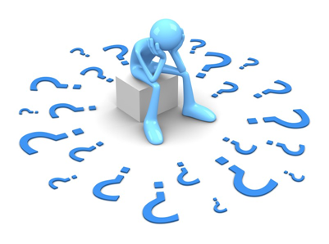
Confused?

Slide 4
What impacts on our Identity?

Slide 5
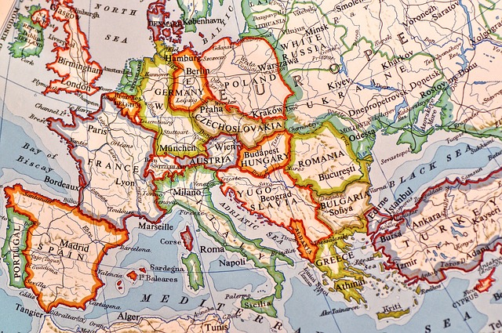
Country

Slide 6
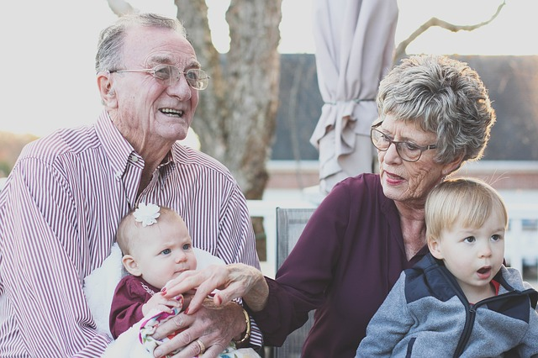
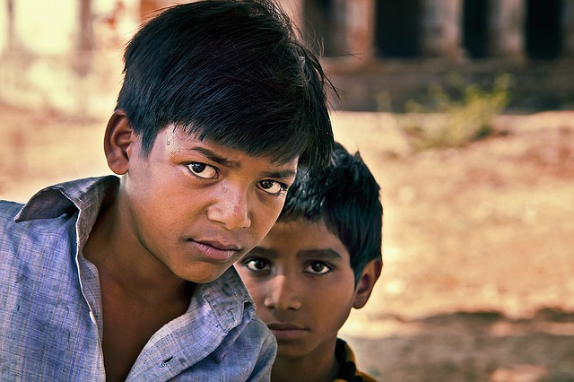
Family

Slide 7
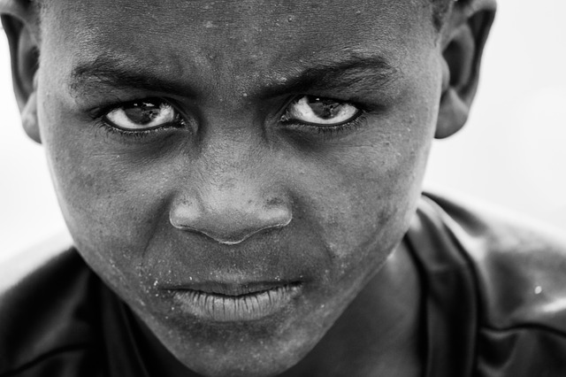
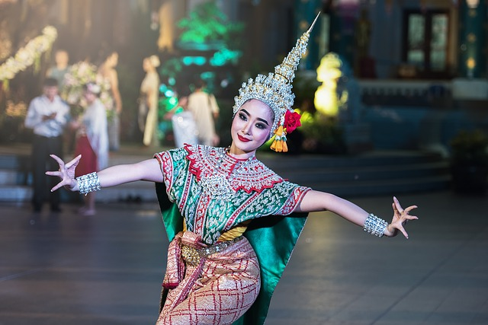
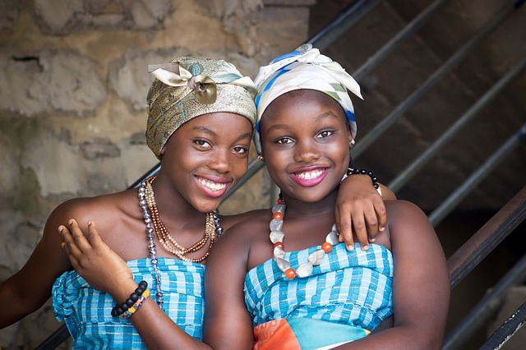
Culture

Slide 8
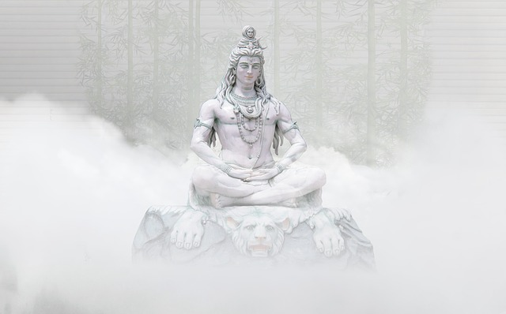
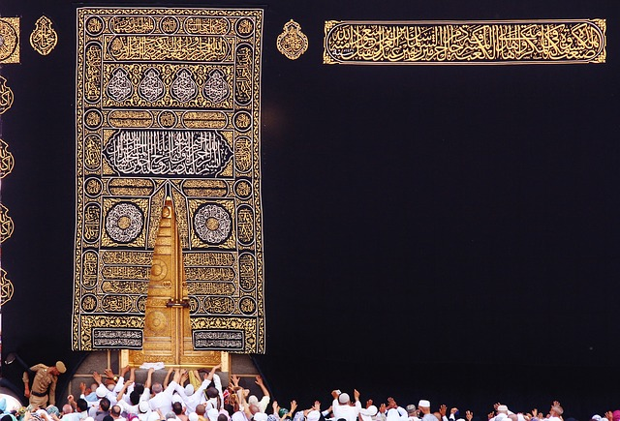
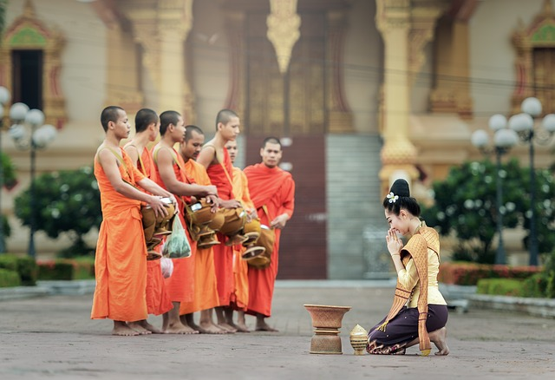
Religion

Slide 9
Other aspects of Identity
Education
Job
Hobbies/Interests
Gender
Me
Friends
Age
Ability/disability
Media

Slide 10
Activity 1 – My Story
(Example) Hobbies- Dancing
My name is…..
(Example) Religion- Buddhist

Slide 11
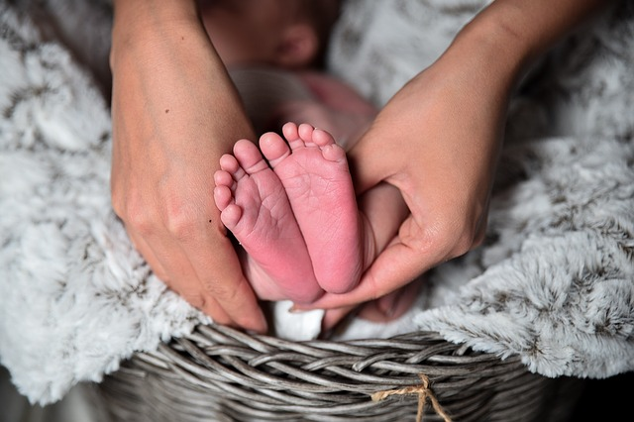
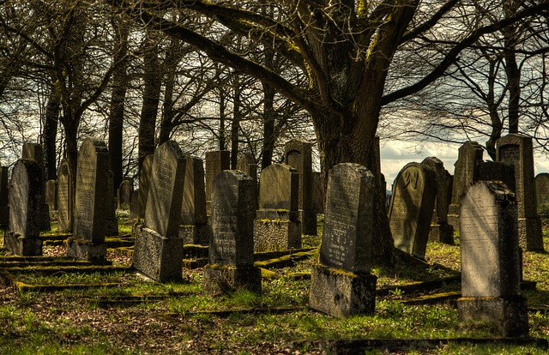
Activity 2 – Life Stories

Slide 12
Thanks!
All photographs courtesy of Pixabay.com
This project has been funded with support from the European Commission.
This document reflects the views only of the author and the Commission cannot be
held responsible for any use which might be made of the information contained herein.
Project Number: 2017-1-FR01-KA204-037126

