Slide 1
Our common home: Europe
Notes:
This resource wants to valorize the role of our common home: Europe. In fact, several times we forget why Europe is important and what is the meaning of “Our” and “Common”.

Slide 2
Index
The Motto of everyone
12 stars
The Infrastructure
Decision making process
Our Common values
Notes:
We will try to surf through 5 issues. First of all, we will go deeper into the motto of the European Union and we will analyse the 12 stars represented on the EU flag. Then we will say some word on the infrastructure and institutions of the EU, underlining that it is quite impossible to understand the decision-making process on which it is based on. The last section – the long one - will explain what are our common values.

Slide 3
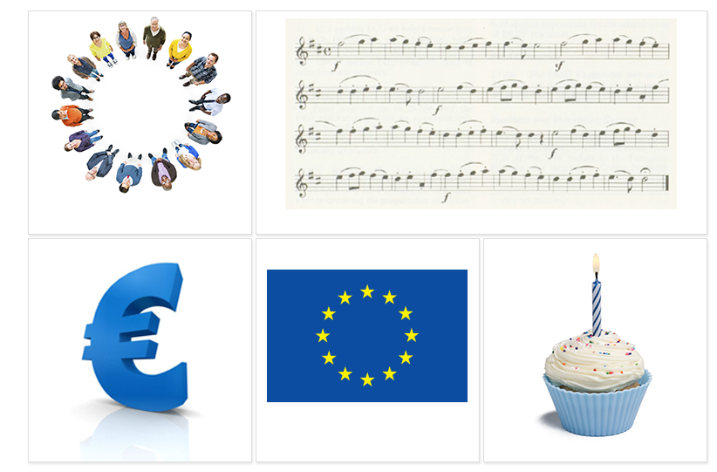
The motto of everyone
Обединен в многообазието
Ujedinjeni u različitosti
Jednotná v rozmanitosti
Forenet i mangfoldighed
In verscheidenheid verenigd
United in diversity
Ühinenud mitmekesisuses
Moninaisuudessaan yhtenäinen
Unie dans la diversité
In Vielfalt geeint
Ενωμένοι στην πολυμορφία
Egység a sokféleségben
Aontaithe san éagsúlacht
Unita nella diversità
Vienota dažādībā
Suvienijusi įvairovę
Magħquda fid-diversità
Zjednoczona w różnorodności
Unida na diversidade
Uniţi în diversitate
Zjednotení v rozmanitosti
Združena v raznolikosti
Unida en la diversidad
Förenade i mångfalden
Notes:
The motto of the European Union is “United in Diversity”. It was decided in 2000. Proposals came from more than 80.000 young people aged between 10 and 19 from all Europe.
To explain the meaning of the motto, it is important to refer to the preamble to the Treaty, where there is underlined that “peoples of Europe, while remaining proud of their own national identities and history, are determined to transcend their former divisions and, united ever more closely, to forge a common destiny”.
So, it means that being part of the European Union will add values to our lives, not the opposite. It is like adding another gold medal, another star on the chest.

Slide 4
12 stars
Notes:
And by the way, if we refer to stars, our common flag is made by 12 golden stars on a blue background. The 3 elements represented there have to be considered. First of all, the circle that is a symbol of unity, of the absolute and of perfection. It represents also the parity of the Member States because in a circle all the points of the circumference are equidistant from the centre.
Then, the 12 stars represent independence, unity, liberty, renewal and hope. Why 12? Because it is considered to be an ideal number. Do you remember how many signs of the zodiac there are? And the months of the year? And what about the hours of the day? And those of the night? And the labours of Hercules?
Last but not least, the blue chosen for the background is the colour of the sky and the universe.
In a general way, the flag of the European Union expresses harmony, peace and respect and balance.

Slide 5
The infrastructure
European Council (Summits)
European Parliament
Council of Ministers
(the Council)
European Commission
Court of Justice
European Court of auditors
European Economic and Social Committee
European Committee of the Regions
European Investment Bank
Agences
European Central Bank
Notes:
And when we talk about balance, all homes and houses are built in a balanced way. So now we can talk about the infrastructure and institutions of the EU. We will say only some words about the principal institutions, trying to inspire you and to convince you to go deepen autonomously.
First of all, all strategic decisions are taken by the European Council in their “summits”. Here, all the heads of state or government of the 28 EU member states are represented. It is supported by the Council. Its Presidency rotates every 6 months. The Council disposes, the European Commission proposes. In fact, it has the power to propose and draft law. It is the “government” of the Union and each state is represented. Nearly 500 million European citizens are represented by 751 members in the Parliament. The European Parliament is the only directly elected body in the Union.
The last institution on which we will say something is the European Central Bank. It is the bank for the states adopted the euro (19 out of 28 member states) and aims to maintain price stability.
Are you curious and want to go deepen? Take a look in the publication section of the official website of the European Union.

Slide 6
Decision making process
Notes:
Of course, now we know how you feel: a little bit confused. And no one word has been said yet on the decision-making process. But let’s do like that: we will try to make it simple. From your side, you have to promise you will study it autonomously.
Let’s start.
Two decision-making procedures are in place: the standard one (called codecision) and the special one. Let’s see only how codecision works, because the special one is a residual procedure.
The Commission proposes new initiatives consulting interested parties through public consultations. The Parliament and Council review and propose amendments. Decision is taken only when all involved institution (Commission, Parliament and the Council) agree on it and “vision” is fully shared by them.
P.s: remember you promise to go deepen autonomously!

Slide 7
Our Common values (1)
Article 1: Human dignity is inviolable. It must be respected and protected
Article 2 et 5: Everyone has the right to life and no one shall be condemned to the death penalty, or executed and or be held in slavery or servitude
Article 6: Everyone has the right to liberty and security of person
Notes:
Now we will take a look to common values on which “our home” is based on. In the next 5 slides, we will approach 16 principles stated in the EU Charter of Fundamental Rights. I would like to remember you that European Union is “founded on the indivisible, universal values of human dignity, freedom, equality and solidarity (and on) the principles of democracy and the rule of law”. That’s what we have to remember to “share a peaceful future based on common values”. So, let’s start our trip toward them.
First of all:
- Human dignity is inviolable
- no one shall be condemned to the death penalty, or be held in slavery
- Everyone has the right to liberty

Slide 8
Our Common values (2)
Article 10, 11, 12: Everyone has the right to freedom of thought, conscience, religion, expression, opinion, as well as freedom of assembly and of association
Article 14: Everyone has the right to education and to have access to vocational and continuing training
Article 20 et 22: Everyone is equal before the law and cultural, religious and linguistic diversity is respected
Article 15: Everyone has the right to engage in work and to pursue a freely chosen occupation, as well as to seek employment, to work, to exercise the right of establishment and to provide services in any Member State
Notes:
Everyone has the right to freedom of thought, religion, opinion
Everyone has the right to have access to education
Everyone has the right to work
Everyone is equal and diversity is respected

Slide 9
Our Common values ( 3)
Article 21: Any discrimination based on any ground such as sex, race, colour, ethnic or social origin, genetic features, language, religion or belief, political or any other opinion, membership of a national minority, property, birth, disability, age or sexual orientation shall be prohibited.
Article 23: Equality between men and women must be ensured in all areas, including employment, work and pay. The principle of equality shall not prevent the maintenance or adoption of measures providing for specific advantages in favour of the under-represented sex.
Notes:
Any discrimination based on sex, race, colour, ethnic, social origin, genetic features, language, religion, belief, political or any other opinion, membership of a national minority, property, birth, disability, age or sexual orientation shall be prohibited.
Equality between men and women must be ensured in all areas, including employment, work and pay

Slide 10
Our Common values (4)
Article 24: Children shall have the right to such protection and care as is necessary for their well-being. They may express their views freely
Article 25: The Union recognises and respects the rights of the elderly to lead a life of dignity and independence and to participate in social and cultural life
Article 26: The Union recognises and respects the right of persons with disabilities to benefit from measures designed to ensure their independence, social and occupational integration and participation in the life of the community
Article 47: Everyone is entitled to a fair and public hearing within a reasonable time by an independent and impartial tribunal previously established by law. Everyone shall have the possibility of being advised, defended and represented
Notes:
Children shall be protected
Elderly shall lead a life of dignity and independence
Persons with disabilities are protected and supported
Independent and impartial tribunal are established to assure the rule of law

Slide 11
Our Common values (5)
Article 41: Right to good administration
Article 45: Every citizen of the Union has the right to move and reside freely within the territory of the Member States. Freedom of movement and residence may be granted, in accordance with the Treaty establishing the European Community, to nationals of third countries legally resident in the territory of a Member State.
Article 48: Everyone who has been charged shall be presumed innocent until proved guilty according to law. Respect for the rights of the defence of anyone who has been charged shall be guaranteed.
Notes:
All citizens have the right to good administration
Everyone is presumed innocent until proved guilty according to law
Every citizen of the Union has the right to move and reside freely within the territory of the Member States.

Slide 12
Thank you!
This project has been funded with support from the European Commission.
This document reflects the views only of the author and the Commission cannot be
held responsible for any use which might be made of the information contained herein.
Project Number: 2017-1-FR01-KA204-037126

