Slide 1
Path to a life project
Notes:
This resource outlines the importance of gaining awareness about the need of lifelong guidance for all and the opportunity to access to specific territorial public services devoted to this task with adult people.
Also approaching adult education courses people can generally benefit to an initial orientation among the training offers. Lifelong guidance means allowing themselves to exploit the occasion to stop and reflect about themselves. This resource fosters the importance of lifelong learning and is targeted to awake the awareness about the dynamic evolutions of our societies and how they affect our lives.

Slide 2
Transition phases
Notes:
The need to cope with transition phases, or to make important decisions or unexpected changes in own personal living condition, are situations that can happen to each of us. In these cases, suggesting to face these challenges as opportunity to improve themselves, guidance pathways and new learning occasions can be a good starting approach.

Slide 3
Basic values and knowledge
Key priorities of the Action Plan on the integration of third country nationals, Brussels, 7.6.2016 COM(2016) 377 final
[..] Experience shows that integration policies work best when they are designed to ensure coherent systems that facilitate participation and empowerment for everyone in society – third country nationals and the communities into which they settle. This means that integration should go beyond participation in the labour market and mastering the language of the host country: integration is most effective when it is anchored in what it means to live in diverse European societies. […]
[..] Successful integration is a process that happens over time, but most importantly, across many different policy areas
e.g. education, employment, entrepreneurship, culture
and in different contexts. […]
Notes:
Moving to a new country the communication with a new language can be a real challenge, but in all EU countries the basic knowledge of the receiving country language is a pre-requisite to have the permit of stay. Specific Adult Education centres, public or private, provide targeted learning provision and certifications. In some cases are also included guidance services and counselling for further training. Counselling and guidance services are almost oriented to the employment search or for developing/improving own professional conditions or status.

Slide 4
Notes:
Counselling and guidance services are often provided by a vast audience of social actors, public and private, and they are targeted to their counselling aims; like schools and universities (educational guidance), health care services (families support and women health prevention), social care services (psychological supports and inclusion interventions), training and employment agencies (further training, validation of prior learning and job search), chambers of commerce or sectoral associations (self-employment and entrepreneurship) etc.

Slide 5
Lifelong Guidance and Learning
http://www.cedefop.europa.eu/en/events-and-projects/projects/lifelong-guidance
Notes:
Lifelong guidance and lifelong learning are the core concepts.
Lifelong guidance aims to provide career development support for individuals of all ages, at all career stages. It includes careers information, advice, counselling, assessment of skills and mentoring. Quality guidance services should be available to all individuals, regardless of their employment situation, socioeconomic status, ethnicity or gender.

Slide 6
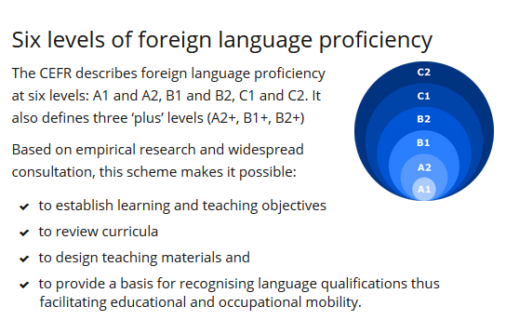
Foreign language proficiency & Adult Education Communities
https://www.coe.int/en/web/common-european-framework-reference-languages/
https://ec.europa.eu/epale/en/home-page
http://lllplatform.eu/policy-areas/inclusive-education/
Notes:
There is a lifelong learning provision specifically targeted to foreign people for learning the receiving country language, providing certifications according to the European Framework of Reference for Languages, because the proficiency in the local language is considered one of the most important factor of integration.
Ensuring equal access to education and training is essential so that every individual, regardless of her/his origin, socio-economic status, mental or physical condition, gender or age can benefit from tailored learning opportunities. Access to lifelong learning is a matter of equal chances to participate fully in society, get high-quality jobs and achieve personal development.

Slide 7
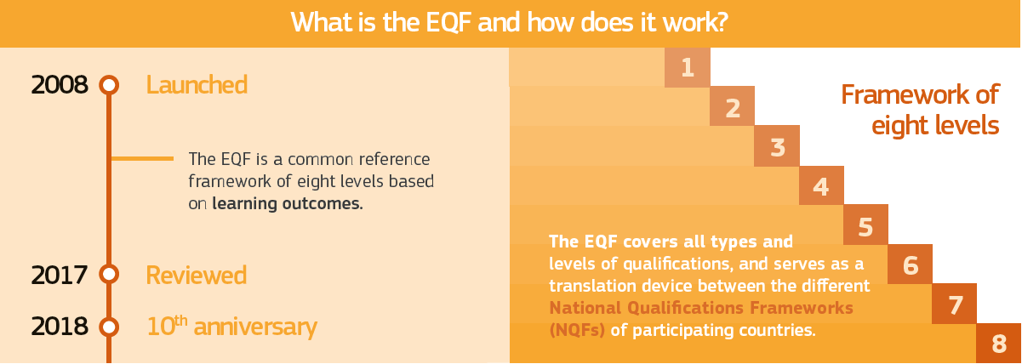
Europass and the European Qualification Framework
https://europass.cedefop.europa.eu/
Notes:
The European Union has developed several frameworks for education. The most famous ones are the European Qualifications Framework (EQF), the Europass, the European Key Competences Framework, and the ECTS and ECVET credit systems. Other tools are being developed such as ESCO that may influence policy reforms in the countries.

Slide 8
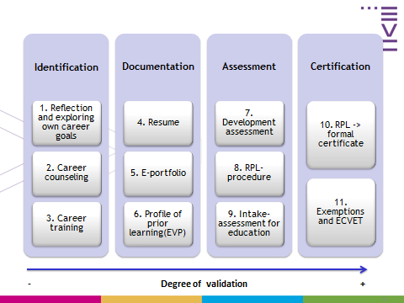
Validation of prior learning
A right for all citizens
Notes:
Another important issue is the validation of prior learning, specifically important for the acquisition of vocational qualifications.
Mechanisms to validate non-formal and informal learning contribute to tackle unemployment and achieve a better match between jobs and skills by acknowledging those acquired outside the formal education system. Validation of non-formal and informal learning also gives opportunities for second chances, improves access to education and enhances motivation to learn. It contributes to social inclusion, personal development, empowerment and employability.

Slide 9
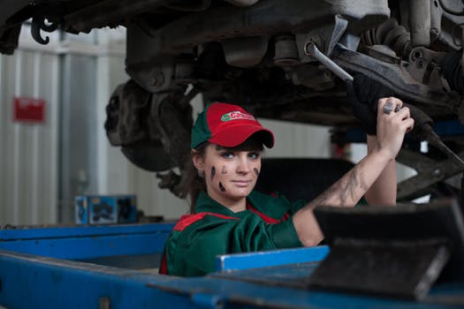
Public Employment Services
Notes:
In EU countries, public employment services (PES) are the authorities that connect jobseekers with employers. Although structured differently in each country, all PES help match supply and demand on the labour market through information, placement and active support services at local, national and European level.

Slide 10
Women entrepreneurship
Current situation of female entrepreneurs in the EU:
women constitute 52% of the total European population but only 34.4% of the EU self-employed and 30% of start-up entrepreneurs
female creativity and entrepreneurial potential are an under-exploited source of economic growth and jobs that should be further developed.
When establishing and running a business, women face challenges such as:
access to finance
access to information
training
access to networks for business purposes
reconciling business and family concerns.
Notes:
Even though there are more women than men in Europe, female entrepreneurs represent only a third of the self-employed in the EU. There are some additional factors (such as reconciling business and family) that make entrepreneurship a less attractive option for them than for men. The European Commission is working with EU countries to overcome these and encourage more women to start their own companies. Female creativity and entrepreneurial potential are an under-exploited source of economic growth and jobs that should be further developed.

Slide 11
Path to life project GRID
Service Institution | 1 | 2 | 3 | 4 | 5 | Proposals of improvement
Rates
1 = totally insufficient
2 = insufficient
3 = acceptable (standard)
4 = good and appropriate
5 = very good – excellent
Notes:
After this quick overview of guidance, lifelong learning and employment services, start your evaluation exercise by writing on the Path to a life project Grid which institutions you met during your stay in the new country, and through which you had access to guidance, training and other supports services. Name them, and specify the effective impacts of these experiences on your personal life (what you learned, if and how did you apply it, what was wrong or inappropriate for your values).

Slide 12
Path to life project
SUMMATIVE MATRIX
List here the improvements proposals
1)
2)
3)
Totally insufficient
Insufficient
Standard
Good and excellent services
Notes:
Then, exchange with your group the evaluation Grids, explain your scores and summarize the results in the Summative Matrix. For each typology of service you will obtain a “Qualitative Mapping” of the guidance and training provision in your local context.
The last task consists in listing the improvements proposals the group want to point out and produce a common text of recommendations to address to the interested decision makers … Identify the recipients of your requests and send them … It will be interesting to know the feedback you will receive!

Slide 13
Thanks!
Developed by Speha Fresia (IT)

