Slide 1
Take the initiative
Notes:
This resource is focused on the key skill “sense of initiative and entrepreneurship” (EU, 2006) and is targeted to introduce some concepts and facilitate reflections and argumentations about this key skill in personal, social and working life. The source of the images is www.unsplash.com/.

Slide 2


Key competences for Lifelong Learning – Sense of initiative
Notes:
The Recommendation of the European Parliament and of the Council of 18 December 2006 on Key Competences for Lifelong Learning (2006/962/EC) provided the following definition:
Sense of initiative and entrepreneurship refers to an individual's ability to turn ideas into action. It includes creativity, innovation and risk-taking, as well as the ability to plan and manage projects in order to achieve objectives.

Slide 3




Personal, Social and Working Life
Notes:
This key competence supports individuals, not only in their everyday lives at home and in society, but also in the workplace in being aware of the context of their work and being able to seize opportunities, and is a foundation for more specific skills and knowledge needed by those establishing or contributing to social or commercial activity. This should include awareness of ethical values and promote good governance.

Slide 4

Essential knowledge, skills and attitudes
Notes:
Essential knowledge, skills and attitudes related to this competence:
Necessary knowledge includes the ability to identify available opportunities for personal, professional and/or business activities, including ‘bigger picture’ issues that provide the context in which people live and work, such as a broad understanding of the workings of the economy, and the opportunities and challenges facing an employer or organisation.

Slide 5
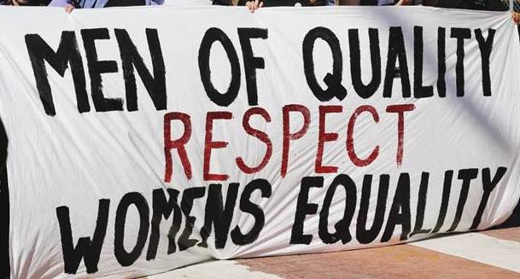
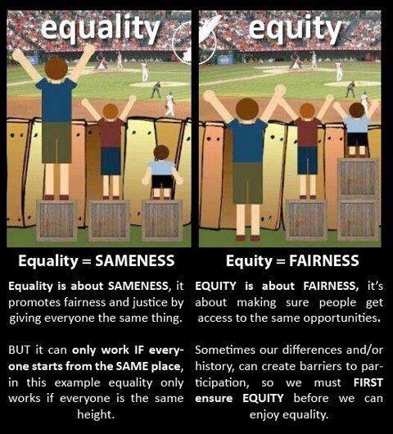

Social Entrepreneurship
Notes:
Individuals should also be aware of the ethical position of enterprises, and how they can be a force for good, for example through fair trade or through social enterprise.

Slide 6

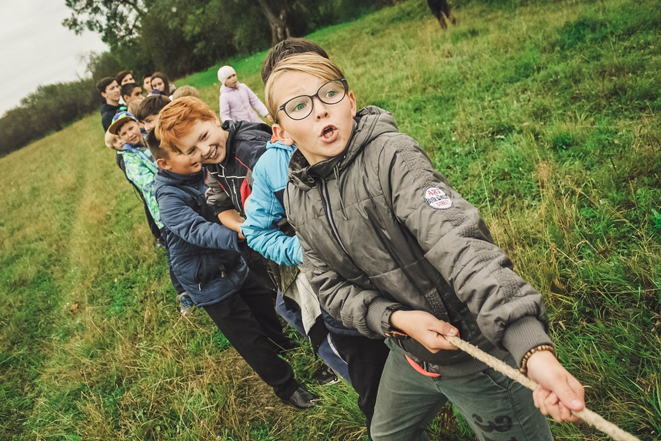

Proactive project management skills
Notes:
Skills relate to proactive project management (involving, for example the ability to plan, organise, manage, lead and delegate, analyse, communicate, de-brief, evaluate and record), effective representation and negotiation, and the ability to work both as an individual and collaboratively in teams.

Slide 7


Proactive project management skills
Notes:
The ability to judge and identify one's strengths and weaknesses, and to assess and take risks as and when warranted, is essential.

Slide 8


Entrepreneurial attitude
Notes:
An entrepreneurial attitude is characterised by initiative, pro-activity, independence and innovation in personal and social life, as much as at work. It also includes motivation and determination to meet objectives, whether personal goals, or aims held in common with others, including at work.

Slide 9
Take the initiative
Exercise Grid 1 – Ethical values
In personal life | In social life | In working life
Notes:
Now, with the first Exercise Grid, “List your ethical values in personal, social and working life”, take 10’/15’ to write them down or to find a symbol useful to define a specific value. Sharing these values within the group you will find for sure the same one indicated by more than one person, or similar values expressed in different ways…after the discussion make a “group mind map”, where, in the middle, there is the most quoted value in the three different fields.

Slide 10
Focus on working life
Exercise Grid 2
Entrepreneurship
Notes:
First in-depth topic (Focus on working life)
Reflecting on the ethical values emerged and discussed in the group, do you find any connection with the list of abilities and attitudes identified by the EU Recommendation for the key skill “entrepreneurship”? Now, with the second exercise grid try to assess, for each ability and attitude, the level of importance, choosing among the three options: high, medium and low. After this individual exercise (10’/15’), share your choices in the team and make a summary of the most important items for the group, and identify the ways to strengthen those skills and attitudes with higher scores.

Slide 11

Focus on social and personal life
Open argumentations
To live the democracy
Notes:
Second in-depth topic (Focus social and personal life)
How do you feel with the “common group mind map”? Are you comfortable with the “majority” vision? One of the key principle in democracy is the respect of minorities and you can discuss about the “Tyranny of Majority”.
http://democracyweb.org/majority-rule-principles
Democracy is a way of government of the people which is ruled by the people. Democracies understand the importance of protecting the rights, cultural identities, social practices, and religious practices of all individuals. In order for the people’s will to govern, a system of majority rule with respect to minority rights has been put into place.

Slide 12
Thanks!
Developed by Speha Fresia (IT)

